Slide 1
This is a Growth Experience
You’ll spend 50+ hours in your clinical setting this semester. Get to know your students so you can get to know how to craft lessons they can connect with.
Read the summative evaluation now, your CT will fill this out at the end of the experience (Uhigh TCH site) and will meet with you at the end of the clinical about your growth.
Log each and every hour-including your planning time, lessons, professional development sessions, extracurricular experiences, and other observations.
Ask your CT about their expectations. Don’t be afraid to ask questions and to ask how you can help. Do your best to support and contribute to student learning.
Be responsive to your cooperating teacher’s feedback and suggestions. They want you to succeed. Demonstrate respect for their expertise.

Slide 2
Dr. Vickie Graziano U-High Clinical Coordinator

Slide 3
Summary of Experience
This week and next week: meet your CT and attend your class
Week of Sept 14 - 16: attend 2 Professional Development Sessions and your class at least one time
Remaining weeks: Attend your class every T/W/Th. Work with your Cooperating Teacher on Lesson Planning and Teaching. Complete 3 hours of outside observations and 5 hours of extra-curricular observations

Slide 4
Where to Find Information

Slide 6
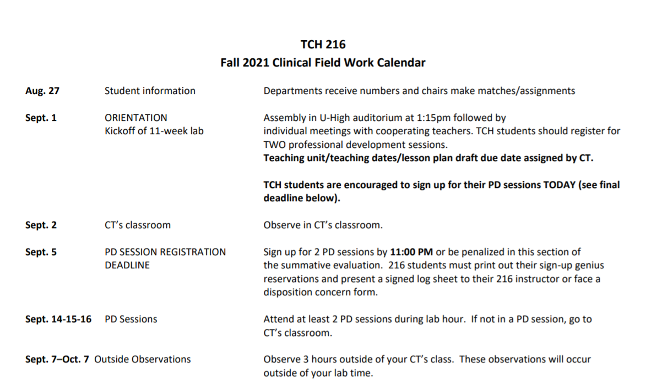

Slide 7
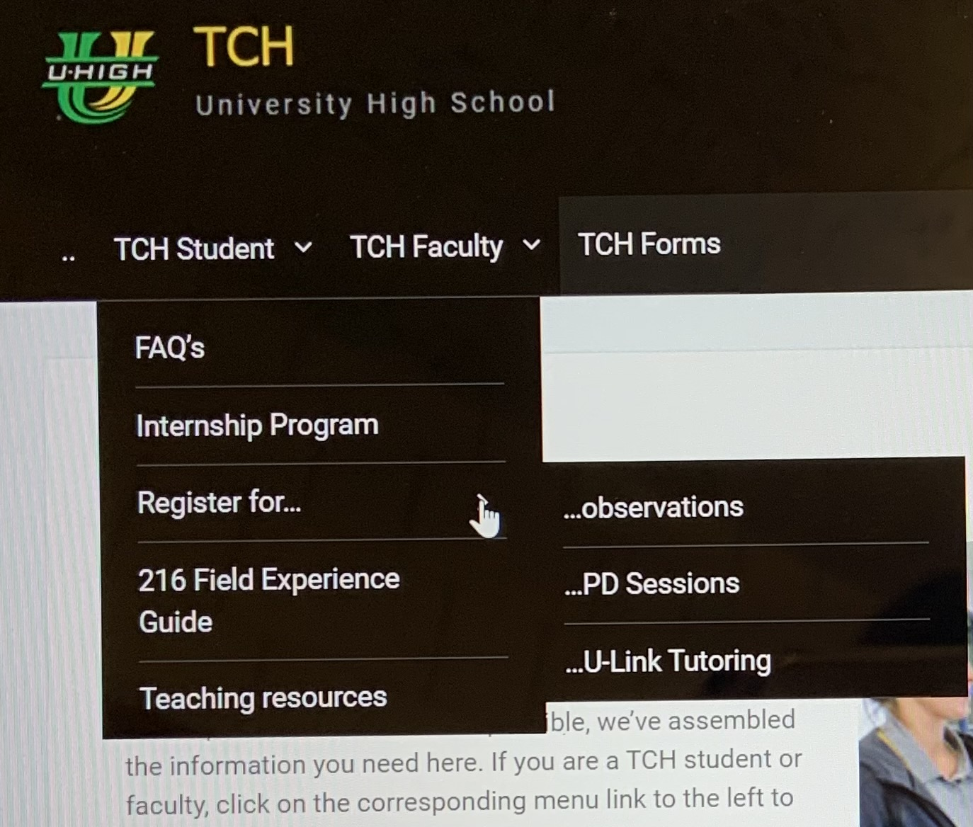

Slide 8
Questions
Contact Vickie Graziano: vegrazi@ilstu.edu

