Slide 1
The Role of the TCH 216 Clinical Experience in the ISU Teacher Education Quality Assurance System

Slide 2
ISU Teacher Education Quality Assurance System
4 Key Assessments
Content Exam
Formative Pedagogy
edDispositions
edTPA
5 Key Areas Examined
Content Knowledge
Pedagogy
Impact on Student Learning
Clinical Practice
Dispositions

Slide 3
Instructors submit data
Program findings (AAR report) are submitted to UTEAC and reviewed /provided with feedback
Programs use UTEAC feedback and AAR findings to make changes
Programs implement changes/instructors execute changes
Instructors asses student performance
Data is disaggregated to create program reports
Reports sent to programs
Programs analyze data, determine performance status, and create action. plans
Annual Assessment Review Process

Slide 4
Key Assessments in the U-High Clinical Experience
Pedagogy Portfolio
Used as the formative pedagogy assessment for a majority of secondary and P-12 programs
Assessed by TCH 216 instructor
Clinical Experience Summative Evaluation
edDispositions assessment is embedded
Assessed by the U-High faculty associate

Slide 5
Components of edTPA
Task 1: Planning for Instruction and Assessment
Lesson plans
Instructional materials
Assessments
Task 2: Instructing and Engaging in Learning
Video clip(s)
Task 3: Assessing Student Learning
Student work samples

Slide 6
What does the edTPA process look like?
Teach the learning segment…
Collect evidence of instruction (videos)
Collect evidence of assessment (student work samples)
Create edTPA Task 2 (Instruction) &
Task 3 (Assessment)
Plan for the learning segment (Task 1)

Slide 7
edTPA Rubric Blueprint
Task name: Rubric Title Guiding Question
Level 1 | Level 2 | Level 3 | Level 4 | Level 5
Represents the knowledge and skills of a seriously struggling candidate who is not ready to teach | Represents the knowledge and skills of a candidate who is possibly ready to teach | Represents the knowledge and skills of a candidate who is qualified to teach | Represents a candidate with a solid foundation of knowledge and skills for a beginning teacher | Represents the advanced skills and abilities of a candidate very well qualified and ready to teach
Notes:
Every rubric follows this same blueprint
Title
Guiding Question revealing the construct to be assessed
5 level descriptors representing a progression from not ready to advanced beginning teaching
**NOTE to consultants -- candidates who receive scores at Level 3 for all 15 rubrics would have a total score of 45. The nationally recommended passing standard is 42 (mostly 3s with some 4s) and so far states with edTPA policy are setting the passing standard at 41 or lower – in some cases starting as low as 35 and moving the bar higher over time.

Slide 8
edTPA & Pedagogy Portfolio
Pedagogy portfolio intentionally addresses language and performance expectations at a beginning level for 9 edTPA rubrics
Program methods courses and TCH 219 advance candidate knowledge in these rubrics as well as addressing the additional 6
Goal is that teacher candidates have exposure to all of the language and performance expectations of edTPA prior to student teaching

Slide 9
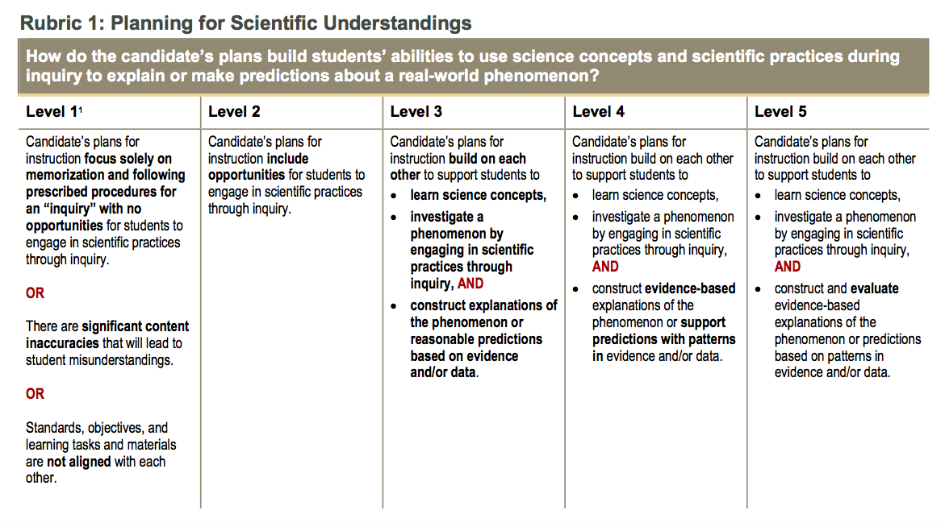

Slide 12
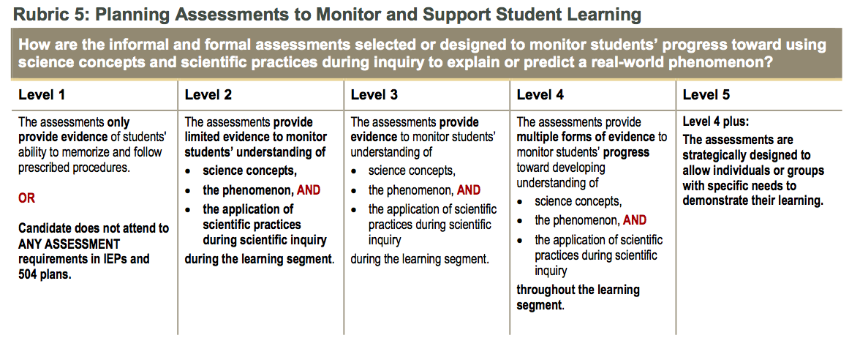

Slide 14
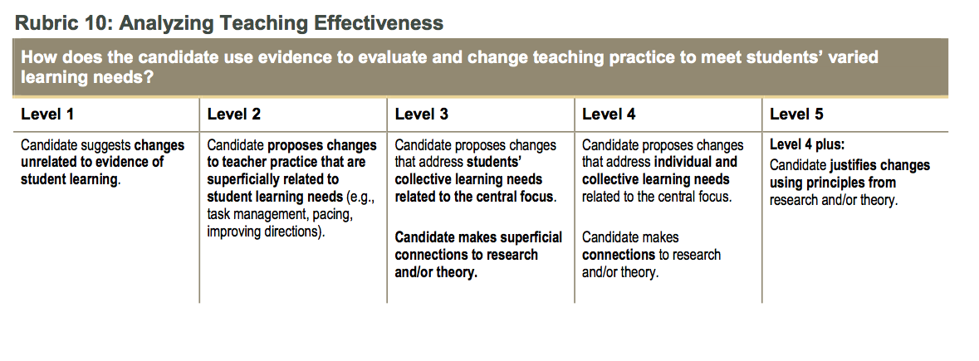

Slide 18
edTPA ISU Performance Summary – Secondary Education January 2017– July 2017
N | Total Mean Score | Planning |  |  |  |  | Instruction |  |  |  |  | Assessment
 |  | P01 | P02 | P03 | P04 | P05 | I06 | I07 | I08 | I09 | I10 | A11 | A12 | A13 | A14 | A15
190 | 45.8 | 3.2 | 3.0 | 3.2 | 2.9 | 3.0 | 3.2 | 3.0 | 3.0 | 3.0 | 2.8 | 3.2 | 3.4 | 2.9 | 3.0 | 3.1

